Slide 1
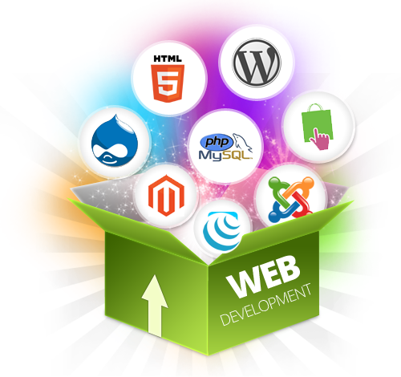
Full Stack
Web Programming
Seven Advanced Academy
Introduction to Web Programming
Lesson 1

Slide 2
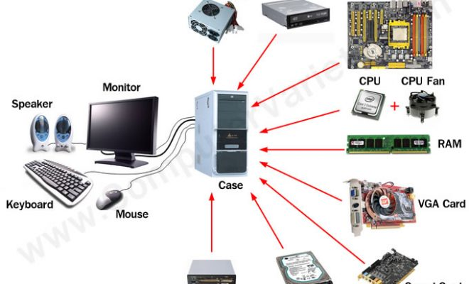
What is a Computer
Notes:
A computer is a device that can be instructed to carry out sequences of arithmetic or logical operations automatically via computer programming. Modern computers have the ability to follow generalized sets of operations, called programs. These programs enable computers to perform an extremely wide range of tasks.
Computers are used as control systems for a wide variety of industrialand consumer devices. This includes simple special purpose devices like microwave ovens and remote controls, factory devices such as industrial robots and computer-aided design, and also general purpose devices like personal computers and mobile devices such as smartphones.

Slide 3
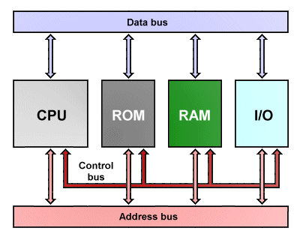
Basic Computer Architecture
Notes:
In computer engineering, computer architecture is a set of rules and methods that describe the functionality, organization, and implementation of computer systems. Some definitions of architecturedefine it as describing the capabilities and programming model of a computer but not a particular implementation.

Slide 4
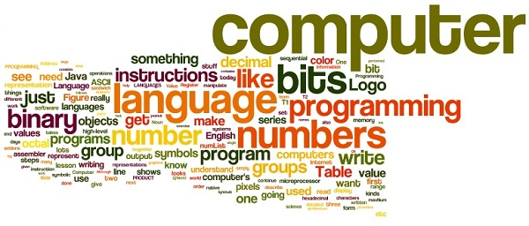
What is Computer Science ?
Notes:
A programming language is a formal language, which comprises a set of instructions used to produce various kinds of output. Programming languages are used to create programs that implement specific algorithms.

Slide 5
What is Computer Programming
Today, most people don't need to know how a computer works. How to interact with a computer program is all the average person needs to know
But, since you are going to learn how to write computer programs, you need to know a little bit about how a computer works
You will learn how to instruct the computer to do things, how most websites you visit are put together to achieve their objectives
Notes:
Today, most people don't need to know how a computer works. they simply turn on a computer or a mobile phone and point at some little graphical object on the display, click a button or swipe a finger or two, and the computer does what they wanted to do. How to interact with a computer program is all the average person needs to know.

Slide 6
Computer Programming
Computer Programming is all about writing a set of instructions the computer will execute
A computer is very dumb, but obedient. It does exactly what you tell it to do, which is not necessarily what you wanted. Programming will help you learn the importance of clarity of expression
Instructions are given to the computer using a programming language
Notes:
One thing that you will learn quickly is that a computer is very dumb, but obedient.

Slide 7
Computer Programming Languages
The computer world of today has more than 500 programming languages and the choice of a programming language is based on many factors like:
Platform
Problem Domain
Popularity (Community)
Learning Curve
Etc ...

Slide 8
Programming Language Classification
Low Level Programming Languages
Usually not understandable by humans
Difficult to program with
Fast to execute
No compilation needed
High Level Programming Languages
Close to English Language
Compiled
Relatively easy to program with

Slide 9
Types of Programming Languages
Web Programming Languages
Mobile Programming Languages
Desktop Programming Languages
Embedded Programming Languages

Slide 10
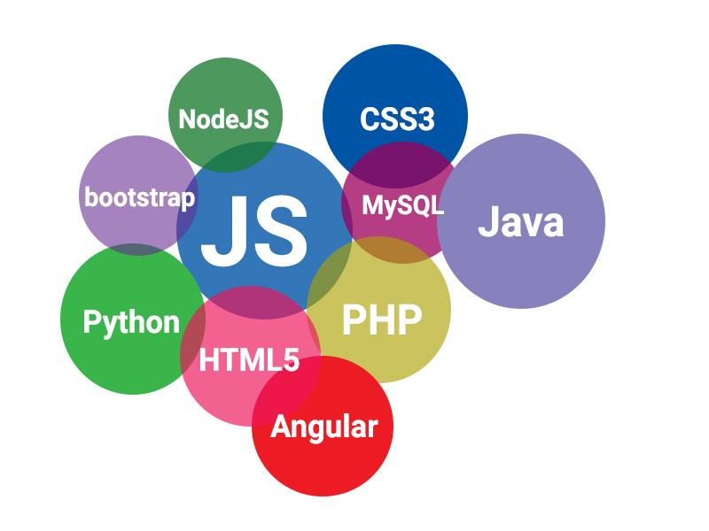
Web Programming Languages

Slide 11
Web Programming Languages
Markup languages
Client-side scripts
Server-side scripts
Notes:
Web languages are languages for every part of your site.
Client-side scripts: are embedded in the HTML markup, and transform your website from a static page to a hard-working, interactive application

Slide 12
Markup Languages
They are the building blocks of most sites, the structure, organization, and the look and feel
Markups are mainly used to build the static parts of the site and the presentation(look-and-feel) of the content
HTML(HTML5), CSS, XML, XHTML, JSON, etc...
Notes:
Web languages are languages for every part of your site.
Client-side scripts: are embedded in the HTML markup, and transform your website from a static page to a hard-working, interactive application

Slide 13
Client-Side Scripts
Create what users interact with on your site by adding interactivity to the site, generating dynamic content and boosting the experience
These scripts are embedded in the HTML markup, and transform your website from a static page to a hard-working, interactive application
JavaScript, ActionScript, jQuery, Angular JS, Polymer, React, Backbone JS, Bootstrap, Foundation, Ember, etc...
Notes:
Web languages are languages for every part of your site.
Client-side scripts: are embedded in the HTML markup, and transform your website from a static page to a hard-working, interactive application

Slide 14
Server-Side Scripts
All sites are hosted on a powerful computer called a server. Server-side code lives on your server and has direct access to your database
Server-side scripts interact with your database, transfer data to the browser, minimize the browser’s workload, and makes your site more secure.
PHP, Python, Ruby on Rails, Java, Perl, JavaScript via Node.js, .Net etc...
C, C++, PHP, Python, Ruby, SQL, MySQL, Node.js, Ruby on Rails, JavaScript via Node.js, etc...
Notes:
Web languages are languages for every part of your site.
Client-side scripts: are embedded in the HTML markup, and transform your website from a static page to a hard-working, interactive application

Slide 15


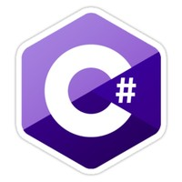


Mobile Programming Languages

Slide 16
Mobile Programming Languages
Android Languages
Java: most popular programming language as of June 2017
Kotlin: was developed to address some of the issues in Java
iOS Languages
Swift: mainstream language for Apple app ecosystem
Objective-C: was the original development language for iOS
Cross-Platform Languages
Ionic 2, React Native, TypeScript, C#, C, C++, Ruby, Python

Slide 17
Desktop and Embedded Languages
Java, C++, C, C#
AIML, LISP, PROLOG, Python, PLANNER, STRIPS
Javascript

Slide 18
History of Web Programming
Internet (1960s)
World Wide Web - WWW (1991)
First Web Browser - Netscape, 1994
IE, 1997 > Opera, 2005 > FireFox, 2006 > Safari, 2007 and Chrome, 2008
Google, 1998
Facebook, 2004

Slide 19
Web Programming Cont.
In Web Programming, there are two main development tracks:
Front-End Development
Back-End Development

Slide 20
Front-End Web Programming
A mix of programming and layout that powers the visuals and interactions of the web
If a website were a house, front-end web development would be the pretty exterior that gives the house character, or the host that invites guests in and makes them feel at home
The frontend of an application is less about code and more about how a user will interpret the interface into an experience
Notes:
For example, once you started to use Facebook, you almost certainly had a better experience. You realized that you could socialize with a simpler design, no flashing banner ads, easy-to-find friends, etc.

Slide 21
Front-End Web Programming Languages - HTML
All code in a web application is eventually translated to HTML
It’s the language that web browsers understand and use to display information to users
A Web developer’s understanding of HTML is analogous to a carpenter’s understanding of a screwdriver.
HTML codes are written with a code editor and save with the extension (.html). Example mywebpage.html

Slide 22
Front-End Web Programming Languages - CSS
By itself, HTML is quite plain. HTML does provide some basic styles, but to build a good frontend application, developers must have experience with CSS too.
CSS provides the paint, templates, glitter, buttons, tassel, lights, and many other things that can be used to improve the presentation of a web page
Languages like Sass and LESS are also known as CSS precompilers, but they are simply used to write more efficient and manageable CSS code. Extension (.css)
Notes:
CSS is so commonly used that languages have been built to make writing CSS easier.

Slide 23
Front-End Programming Languages - Javascript
If you could only learn one language in your lifetime, you’d be well-advised to choose JavaScript. It is the most commonly used front-end language
JavaScript is a language that is run on a client machine, making it easy to program fast, intuitive and fun with user experiences, without forcing a user to refresh their web page
Frameworks like Angular, Ember, React and Backbone are all very widely used for JavaScript-heavy front-end programs
Notes:
Though it’s not exclusively a frontend language, that’s where it’s most commonly used
Drag-and-drop, infinite-scroll and videos that come to life on a web page can all be programmed with JavaScript.
JavaScript is so popular that entire frameworks have been built just to make building application front-ends easier.

Slide 24
Back-End Web Programming
The back-end of a web application is an enabler for a frontend experience and has most of the code required to make an application work
The back-end of an application is responsible for things like calculations, business logic, database interactions, and performance
Back-end code is run on the server, as opposed to the client. So, back-end developers not only need to understand programming languages and databases, but they must have an understanding of server architecture as well
Notes:
An application’s frontend may be the most beautifully crafted web page, but if the application itself doesn’t work, the application will be a failure.
If an application is slow, crashes often, or constantly throws errors at users, it’s likely because of backend problems.

Slide 25
Back-End Web Programming Cont.
Back-end development is not all ones and zeros though. Much like front-end development, back-end development has a human aspect to it as well
Most back-end languages – like NodeJS, Python, PHP and SQL – have standardized styles and idioms that make reading and writing code more efficient and enjoyable
Notes:
Since most of the code for an application is written on the backend, it should be easy to understand and work with.

Slide 26
Back-End Web Programming Languages - NodeJS
NodeJS is a server-side platform wrapped around the JavaScript language for building scalable, event-driven applications
JavaScript has not been considered when it comes to the server responding to client requests, but that is exactly what Node.js provides
NodeJS is not written in JavaScript (it is written in C++) but it uses the JavaScript language as an interpretive language for server-side request/response processing
Notes:
This is confusing for even experienced programmers because the traditional JavaScript environment has always been client-side - in a user's browser or in an application that is talking to a server.
In other words, Node.js runs stand-alone JavaScript programs. The advantage is that programmers can use their current, albeit client-side, programming knowledge and begin coding with Node.js much more easily.

Slide 27
Back-End Web Programming Languages - PHP
PHP stands for "Hypertext Preprocessor" and is an HTML-embedded Web scripting language. This means PHP code can be inserted into the HTML of a Web page
When a PHP page is accessed, the PHP code is read or "parsed" by the server the page resides on. The output from the PHP functions on the page are typically returned as HTML code, which can be read by the browser
PHP pages are secure enough to access databases and other secure information
Notes:
Because the PHP code is transformed into HTML before the page is loaded, users cannot view the PHP code on a page. This make PHP pages secure enough to access databases and other secure information.
Originally Mark Zuckerberg made Facebook using PHP(programming language).
As the years progressed, the front end is written in PHP. Much of it is written using XHP, and the runtime is HipHop for PHP. Like most websites there's a lot of JavaScript (programming language) running in the users' browsers.
Most of the back end services are written in C (programming language), C++ and Java. A lot of the C++ services rely on Boost (C++ libraries). Many of the internal tools and some glue code is written in Python (programming language). One of the services that underlies Chat, the channel servers, is written in
Erlang (programming language). The back end services and the web front end communicate using Apache Thrift. The iPhone app and iOS SDK are written in Objective-C (programming language).
OCaml (programming language), Haskell (programming language), and Ruby (programming language) are used internally, but as far as I know they don't power anything available on the website.

Slide 28
Back-End Web Programming Languages - Python
Python is an interpreted, object-oriented programming language similar to PERL, that has gained popularity because of its clear syntax and readability. Python is said to be relatively easy to learn and portable, meaning its statements can be interpreted in a number of operating systems, including UNIX-based systems, Mac OS, MS-DOS
A popular web development framework, Django, also makes Python a popular choice for building web applications
Notes:
Dropbox was built with Python – and still uses – Python to run much of its server-side code.
Python is an interpreted, object-oriented programming language similar to PERL, that has gained popularity because of its clear syntax and readability. Python is said to be relatively easy to learn and portable, meaning its statements can be interpreted in a number of operating systems, including UNIX-based systems, Mac OS, MS-DOS, OS/2, and various versions of Microsoft Windows 98.

Slide 29
Back-End Web Programming Languages - SQL
SQL is a universal database query language
SQL is used to interact with databases, which are a part of every back-end web application
No matter what language or framework you choose to build your web application, you will likely use SQL, or some abstraction of it, to interact with the database

Slide 30
Full Stack Web Development
Full Stack = Front-End + Back-End
Some are of the opinion that a full-stack developer is simply someone who is familiar with all layers in computer software development
These developers aren't experts at everything; they simply have a functional knowledge and ability to take a concept and turn it into a finished product

Slide 31
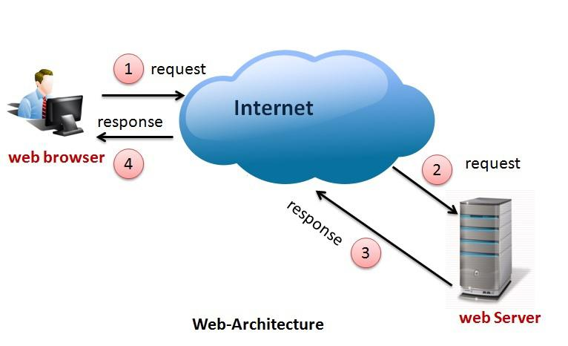
Web Architecture
Notes:
In this section we will go over the main architecture and components which enable the Internet and web functionally to work. I will explain what some of the components are and what they do; also I will show a diagram and explain how the Internet works step by step.
Web architecture terms: world wide web, Internet Service Providers (ISP); web hosting services; Domain structure; domain name registrars; Web Pages.
Common Web protocols: TCP/IP, HTTP, SMTP, FTP

Slide 32
Web Architecture - World Wide Web
The Internet or World-Wide-Web is a global computer network providing a variety of information and communication facilities, consisting of interconnected networks using standardized communication protocols
The original aim was to create a network that would allow users of a research computer at one university to "talk to" research computers at other universities

Slide 33
Web Architecture - Web Servers
To access your website over the World Wide Web you will have to upload it to a web server
A web server could be hardware or software and must be able to allow HTML pages to be shown
Web servers are connected to the internet. They have high communication lines and high speed routers

Slide 34
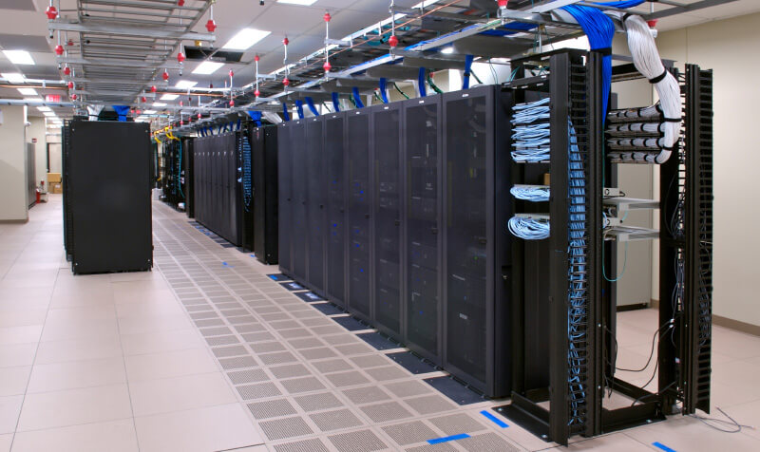
Web Architecture - Web Servers Cont.

Slide 35
Web Architecture - ISP
Internet service providers (ISP) supplies the internet connection to the internet servers to allow them to connect to (www) websites
If you are trying to connect to a specific website both the host and receiver needs an ISP to connect to each other
Examples of ISP are MTN, ORANGE, CAMTEL, etc...
Notes:
All of these companies will provide you with either telephone lines or fibre optic cables for you to be able to connect to their internet server.

Slide 36
Web Architecture - Web Hosting Services
Websites that are put on the internet have to be put on a web server connected to the internet. There are many organisations that you can pay monthly for them to host your website
Web hosting companies can offer many services, they can store your website on their server, upload it so it can be accessed by www. , offer technical support and email address
Eg: Google cloud, AWS, BlueHosting, MTN-Hosting
Notes:
Larger companies and organisations will purchase their own servers to host their websites on because it will work out cheaper in the long run also they can perform their own maintenance.

Slide 37
Web Architecture - Domain Name Servers (DNS)
Domain names are the unique address for where the files for the website are kept and hosted
DNS maintain a directory of domain names and translate them to Internet Protocol (IP) addresses
It is like a telephone book of websites. If you are requesting to go on a website, your request is sent to the domain server to look up your website domain name
If it cannot find the domain name you are looking for it will send the request to another domain name server

Slide 38
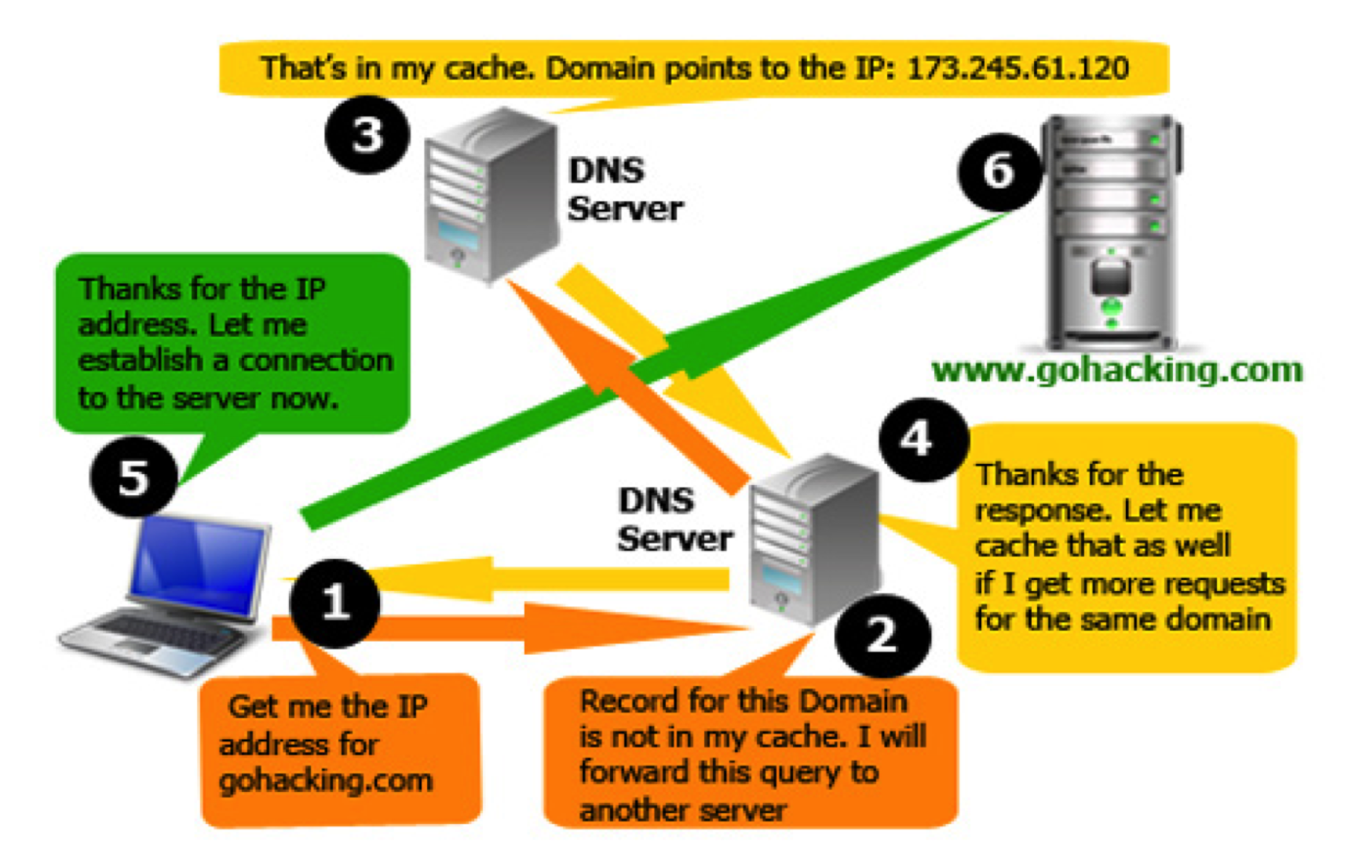
Web Architecture -DNS Cont.
Notes:
Locator (URL) into the address bar of your web browser, web browsers actually don’t use URLs to request web sites from servers; they use Internet Protocol or IP addresses (which are basically like phone numbers or postal addresses that identify servers.)
Try opening a new browser tab or window, typing http://www.apple.com and hitting enter; then type http://17.149.160.10/ and hit enter—you will get to the same place. http://www.apple.com is basically acting as an alias for http://17.149.160.10/, but why, and how?
This is because people are better at remembering words than long strings of numbers. The system that makes this work is called the Domain name system (DNS), which is essentially a comprehensive automatic directory of all of the machines connected to the Internet. When you punch http://dev.opera.com into your address bar and hit enter, that address is sent off to a name server that tries to associate it to its IP address. There are a ton of machines connected to the Internet, and not every DNS server has a listing for every machine online, so there’s a system in place where your request can get referred on to the right server to fulfill your request. So the DNS system looks up the http://www.opera.com web site, finds that it is located at 17.149.160.10, and sends this IP address back to your web browser.
Your machine sends a request to the machine at the IP address specified and waits to get a response back. If all goes well, the server machine sends a short message back to the client with a message saying that everything is okay (see Figure 1,) followed by the web page itself. This type of message is contained in an HTTP header. If something goes wrong, for example you typed the URL incorrectly, you’ll get an HTTP error returned to your web browser instead—the infamous 404 “page not found” error is the most common example you’ll come across.

Slide 39
Web Architecture - Domain Name Structure
Every website is identified by a unique address which is called an IP address
An IP address can be for a website, server, computer, laptop, mobile. Any device that connects to the internet should have an IP address
IP addresses are made up of 4 groups and from 9 to 11 numbers for example (192.168.0.2). Because these numbers are hard to remember, a domain name will be put in place to access websites. That example would be www.google.com

Slide 40
Web Architecture - Mail Servers
A mail server is the computerized equivalent of your friendly neighborhood mailman. Every email that is sent passes through a series of mail servers along its way to its intended recipient
It also takes rules from the sender on how the email should appear on the receiver’s end. When the email is sent, it is transferred to other mail servers until it reaches the destination
Examples: Gmail, Mailtrap, Mailshift, Yahoo, etc...

Slide 41
Web Architecture - Email Software/Client
Email Software or Email Client is a piece of software on your computer that you use to read and send emails from your computer
The advantage of using an email client is that the emails are stored on your computer and are accessible faster than using a web based email interface
With email client you can read the messages you already received without being connected to the internet
E.g. Outlook Express, Thunderbird

Slide 42
Web Architecture - Routers
To create a network you will need a router to connect devices together. Routers connect multiple networks together
A router acts as a dispatcher. It analyzes data being sent across a network, chooses the best route for data to travel, and sends it on its way
Routers connect your business to the world, protect information from security threats, and can even decide which computers receive priority over others

Slide 43
Web Architecture - Web Browsers
A web browser is a type of software that allows you to find and view websites on the Internet or the World Wide Web
When you run a web browser (web client) on your computer, it contacts a web server and requests information you need. The web server locates and then sends the information to the web browser, which displays the results
Most web browsers now allow you to play videos and sound because they have become increasingly sophisticated
E.g. Google Chrome, Internet Explorer, Safari, Mozilla Firefox
Notes:
Do you describe the HTTP protocol here? Do you differentiate between the types of requests-response here? Talk about stateless and state-driven protocols (http VS ftp)

Slide 44
Web Architecture - Web Protocols
A suite of protocols that turns data into blocks of information called packets, which are then sent across the Internet
Transmission Control Protocol/Internet Protocol (TCP/IP) is the standard protocol used by the Internet that allows computers from different vendors with various operating systems and capabilities to communicate
Hypertext Transfer Protocol (HTTP) is a stateless, application-layer protocol for communicating between distributed systems, and is the foundation of the modern web
Notes:
As a web developer, you must have a strong understanding of HTTP protocol.
Specifically, HTTP is the set of rules required to exchange files – such as text, images, video and multimedia content – across the Web.

Slide 45
Web Architecture - Web Protocols Cont.
HTTP allows for communication between a variety of hosts and clients, and supports a mixture of network configurations
The communication usually takes place over TCP/IP, but any reliable transport can be used. The default port for TCP/IP is 80, but other ports can also be used
A second major version of the HTTP application protocol was developed in the form of HTTP/2, which supports queries multiplexing, headers compression, priority and more intelligent packet streaming management
Notes:
Specifically, HTTP is the set of rules required to exchange files – such as text, images, video and multimedia content – across the Web.

Slide 46
Course Outline
Front-End Fundamentals
HTML5, CSS5, Javascript
Front-End Advanced
Advanced JavaScript, Angular, Bootstrap, Taks runners, Jquery, Libraries, etc ...
Back-End
NodeJS, ExpressJS, MongoDB
Php, Python
SEO, etc ...

Slide 47
Resources
Introduction to Computer Programming
History of The Web

Slide 48
Congratulations!

